Slide 1
Naïve Bayes Classification
Dr Swagato Chatterjee
VGSOM

Slide 2

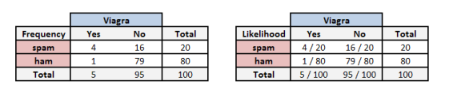
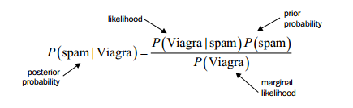
Bayes Theorem

Slide 3
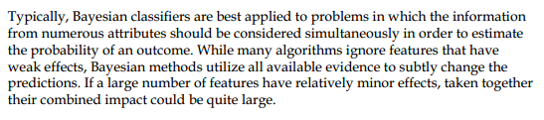
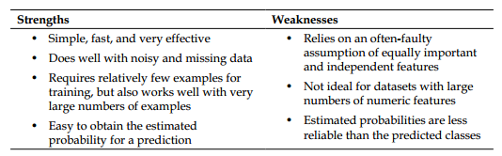

Slide 4
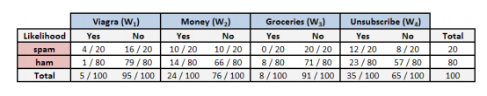
Naïve Bayes Algorithm
A message has the words ‘Viagra’ and ‘Unsubscribe’, but not ‘Money’ and ‘Groceries’
Find the probability of being spam:

Slide 5
A message has all the words ‘Viagra’, ‘Unsubscribe’, ‘Money’ and ‘Groceries’
Find the probability of being spam:
Laplace Estimator

Slide 6
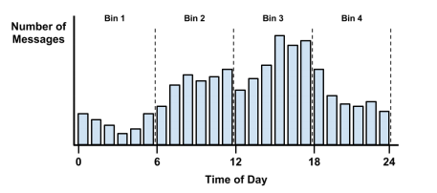
Numeric Factors

